Slide 1
Global Happiness Scores
Informing Public Policy and Predicting Global Needs

Slide 2
Purpose Methods
United Nations Sustainable Development Solutions Network
Identify and analyze the effect of policy changes within a nation on the happiness of its citizens
Use this insight to direct public policy for developing nations or nations in crisis.
Gallop World Poll
Model stacking to improve accuracy
Semi-Supervised Learning

Slide 3
Model Stacking Schema
Data
Gradient Boosting
SVC
XGBoost
Final Prediction
Predictions
+
Data
???
Random Forest
Logistic Regression
SVC
Base Level Estimators
Metaclassifier

Slide 4
Data
Generate Pseudo-Labels
Gradient Boosting
SVC
XGBoost
Final Prediction
Predictions
+
Data
???
Random Forest
Logistic Regression
SVC
Base Level Estimators
Metaclassifier

Slide 5
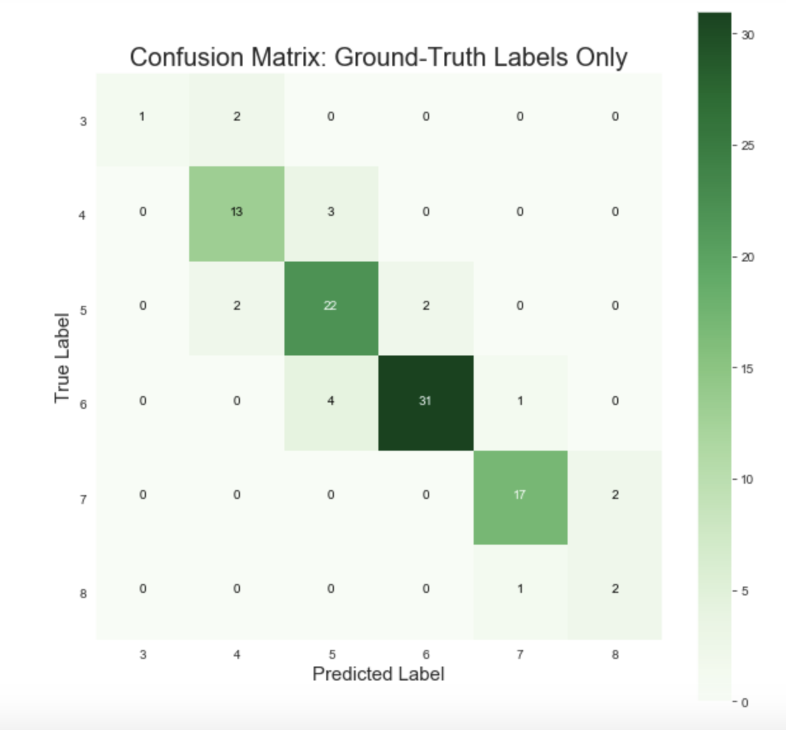
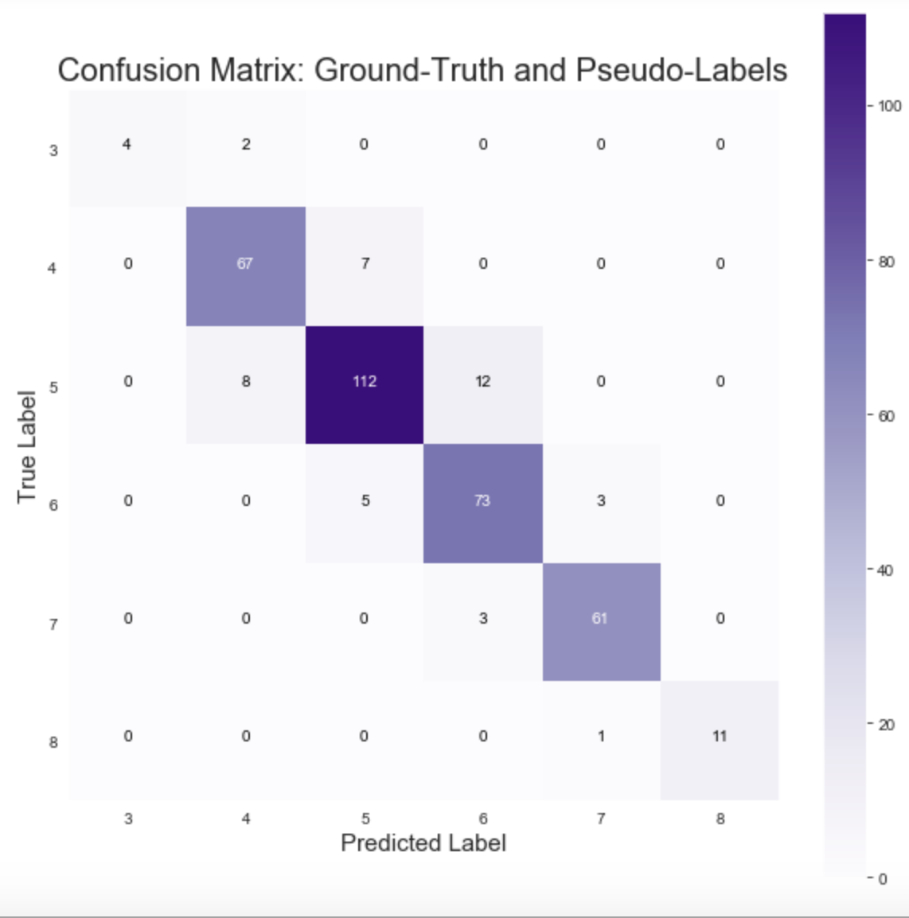
Model Performance
83.5% Accuracy
88.9% Accuracy

Slide 6
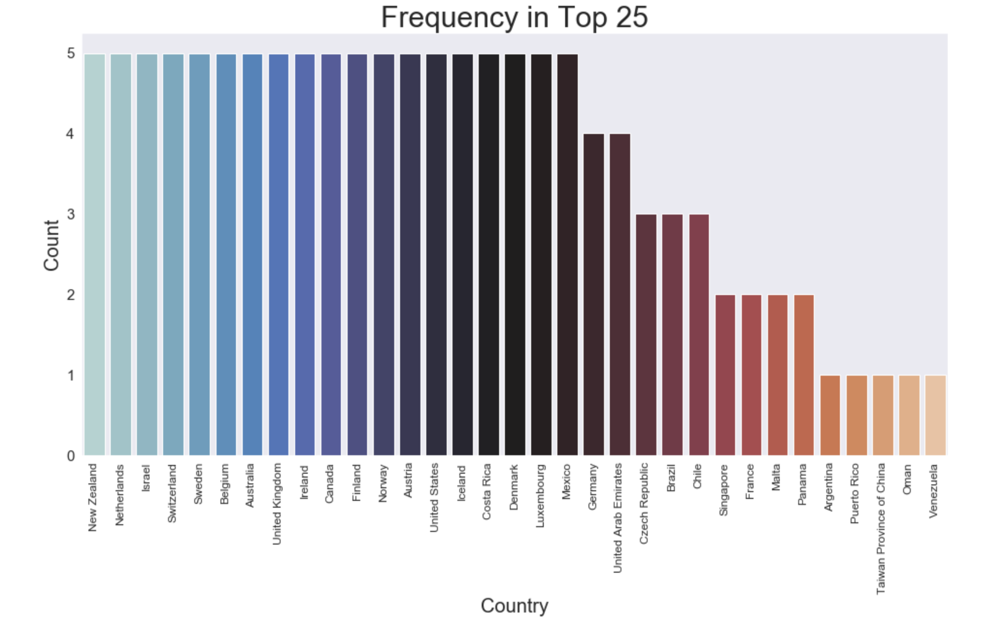
Notes:
Description of most common features of consistent happy countries

Slide 7
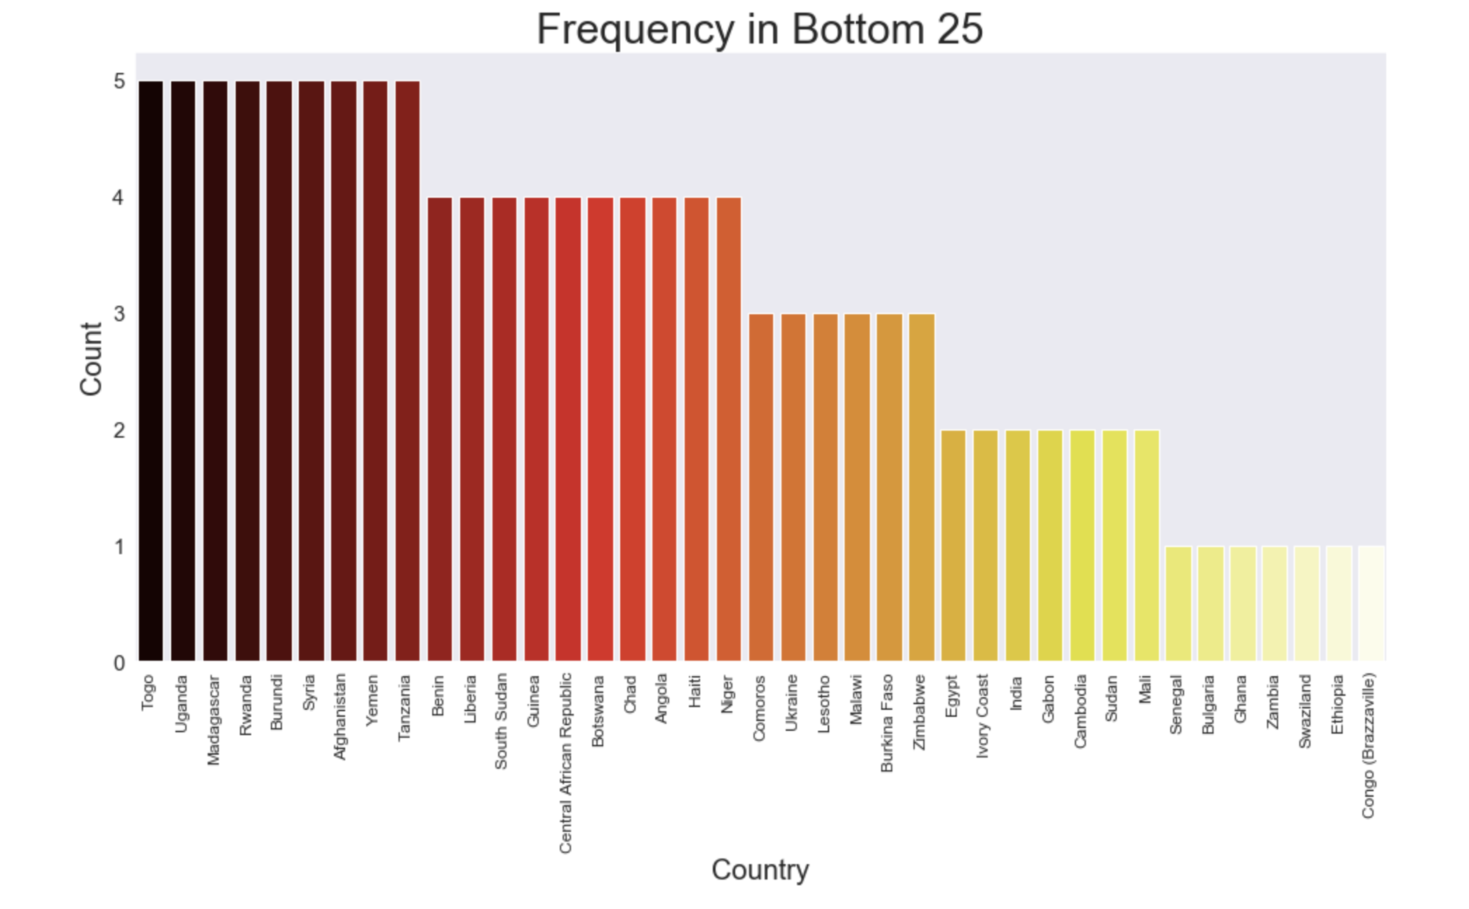
Notes:
Description of most common features of consistent unhappy countries

Slide 8
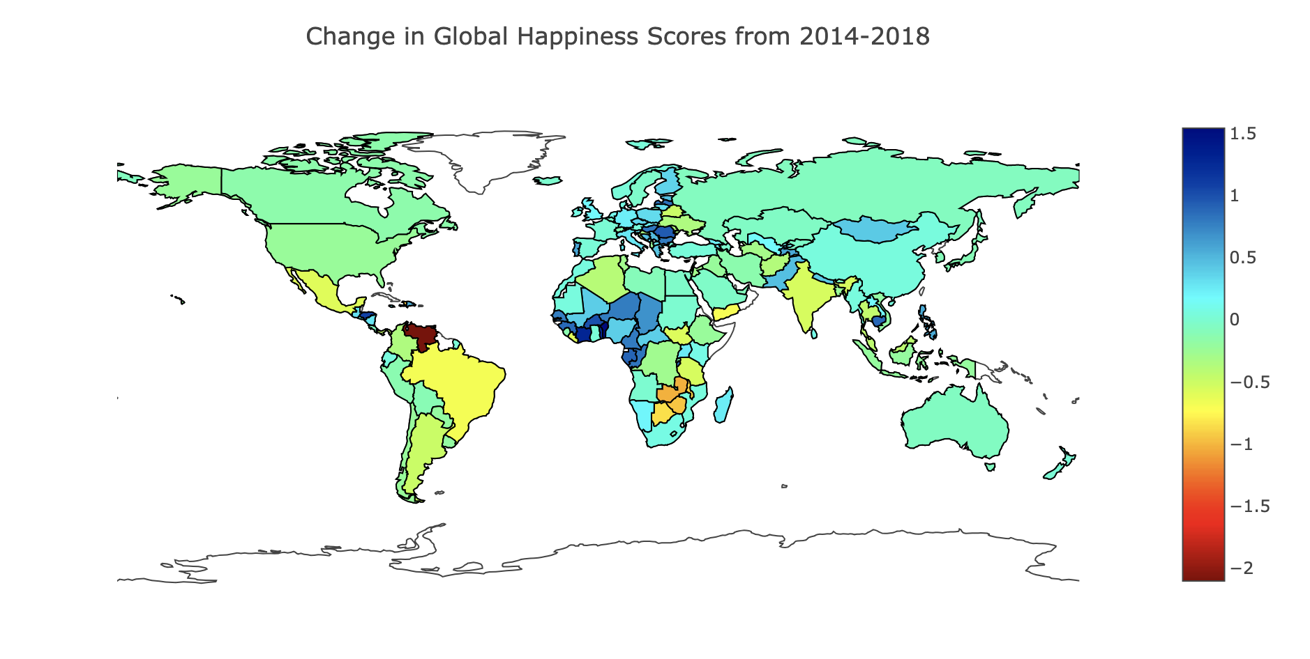
Evaluating Changes in Global Happiness Scores
Venezuela
Benin

Slide 9
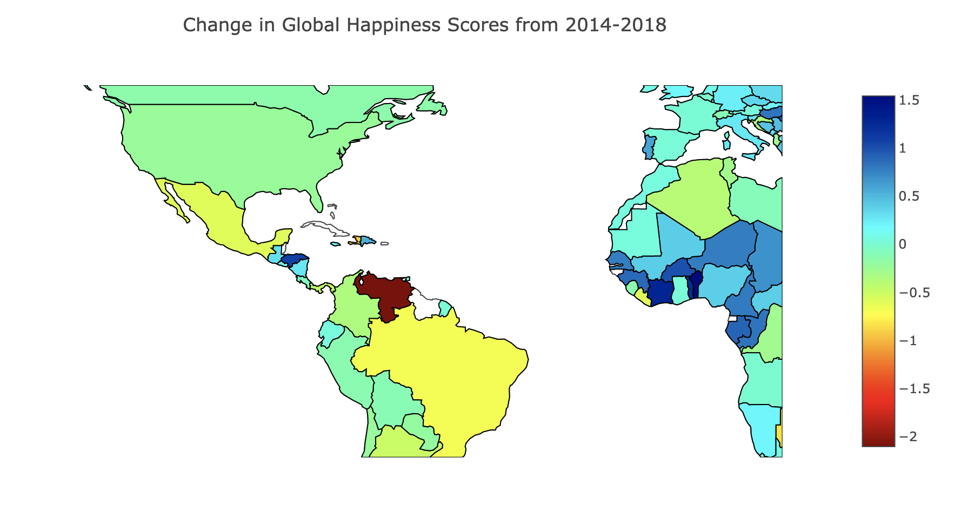
Venezuela
Largest drop since 2014
Debt Rollercoaster
Socioeconomic Crisis
Notes:
Decreased 2.1 points in happiness score since 2014 (6.8-4.7)
Fell 85 ranks since 2014 (22nd to 107th)
Oil glut 1980s → recovery in 2000s --> Hugo Chaves populist social welfare policies (reduced economic inequality and poverty initially, but eventually destabilized nation’s economy)
Socioeconomic crisis = hyperinflation, mass emigration (3 million people), shortages of basic goods, drastic increase in unemployment, child mortality, diseases, malnutrition, and crime

Slide 10
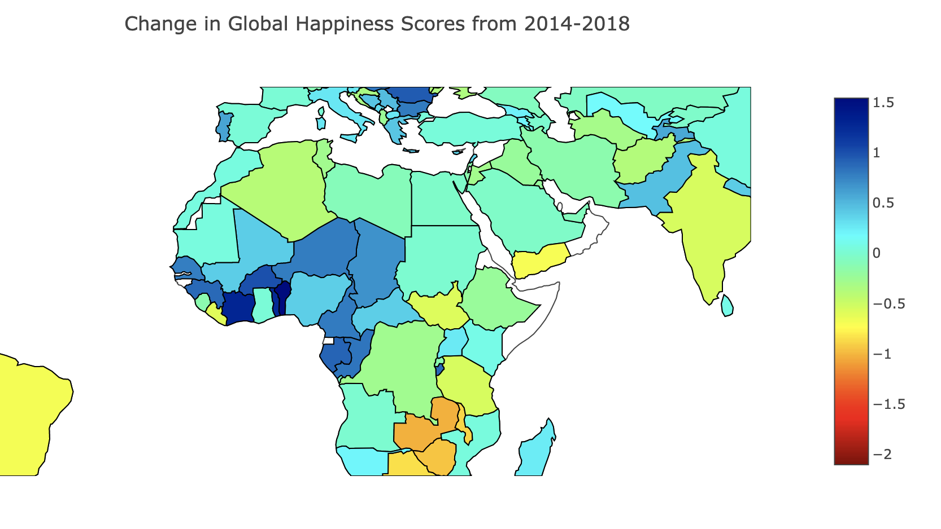
Benin
Largest increase since 2014
Rocky history since gaining independence in 1960
Multiple projects and grants to improve the nation
Notes:
Increased 1.5 in happiness score since 2014 (3.3– 4.9)
Increased 53 positions in rank since 2014 (154th to 101st)
Former French colony, gained full independence in 1960. since has had different democratic governments, military coups, and was Communist 1975 – 1990. In 1979 had a show election where there was only Mathieu Kerekou on the ballot. During his term, multiple policy changes caused foreign nations to withdraw their investments and for teachers in the country to leave. This reorganization was financed by agreeing to take nuclear waste from the Soviet Union and France.
In 2006, Benin had their first free and fair election and received 307 million dollars as part of the Millenium Challenge Grant to improve their judicial system, international commerce, and financial sector.
Africa Coast to Europe Cable in 2011 (reduce prices of data and increase access to internet)
Bamako Initiative (improvements to health)

Slide 11
Recommendations
Use happiness predictions to identify countries at risk for civil unrest
Inform policy decisions of developing countries
Predict the effects of proposed policy changes
Notes:
1. Direct resources and intervene

Slide 12
Future Work
Determine which features have the most influence on happiness scores
Correlate with emigration data
Transform into a regression model to extrapolate predictions of future happiness
Notes:
2. Allocate aid and resources

Slide 13
Thank You
Questions?

